Slide 1
Design Patterns
Singleton Patterns
1

Slide 2
Example: Logger
What is wrong with this code?
  public class Logger
  {
  public Logger() { }
  public void LogMessage() {
  //Open File "log.txt"
  //Write Message
  //Close File
  }
  }

Slide 3
Example: Logger (cont)
Since there is an external Shared Resource (“log.txt”), we want to closely control how we communicate with it.
We shouldn’t have to create the Logger class every time we want to access this Shared Resource. Is there any reason to?
We need ONE.

Slide 4

Singleton
GoF Definition: “The Singleton Pattern ensures a class has only one instance, and provides a global point of access to it.”
Best Uses
  Logging
  Caches
  Registry Settings
  Access External Resources
    Printer
    Device Driver
    Database
4

Slide 5
Logger – as a Singleton
public class Logger
{
private Logger{}
private static Logger uniqueInstance;
public static Logger getInstance()
{
if (uniqueInstance == null)
uniqueInstance = new Logger();
return uniqueInstance;
}
}
Note the parameterless constructor
5

Slide 6
Lazy Instantiation
Objects are only created when it is needed
Helps control that we’ve created the Singleton just once.
If it is resource intensive to set up, we want to do it once.
6

Slide 7
Singleton vs. Static Variables
What if we had not created a Singleton for the Logger class??
Let’s pretend the Logger() constructor did a lot of setup.
In our main program file, we had this code:
  public static Logger MyGlobalLogger = new Logger();
All of the Logger setup will occur regardless if we ever need to log or not.

Slide 8
Threading
public class Singleton
{
private Singleton() {}
private static Singleton uniqueInstance;
public static Singleton getInstance()
{
if (uniqueInstance == null)
uniqueInstance = new Singleton();
return uniqueInstance;
}
}
What would happen if two different threads accessed this line at the same time?
8
Notes:
Result: Each thread could create a Singleton. This is a violation of the Singleton pattern!

Slide 9
Option #1: Simple Locking
public class Singleton
{
private Singleton() {}
private static Singleton uniqueInstance;
public static Singleton getInstance()
{
synchronized(Singleton.class) {
if (uniqueInstance == null)
uniqueInstance = new Singleton();
}
return uniqueInstance;
}
}

Slide 10
Option #2 – Double-Checked Locking
public class Singleton
{
private Singleton() {}
private volatile static Singleton uniqueInstance;
public static Singleton getInstance()
{
if (uniqueInstance == null) {
  synchronized(Singleton.class) {
  if (uniqueInstance == null)
  uniqueInstance = new Singleton();
  }
}
return uniqueInstance;
}
}

Slide 11
Option #2 (C# Example)
public class Singleton
{
private Singleton() {}
private static object syncRoot = new Object();
private static volatile Singleton instance;
public static Singleton Instance
{
get {
if (instance == null) //first check
{
lock (syncRoot)
{
if (instance == null) //second check
instance = new Singleton();
}
}
return instance;
}
}
}
11

Slide 12
Option #3: “Eager” Initialization
public class Singleton
{
private Singleton() {}
private static Singleton uniqueInstance = new Singleton()
public static Singleton getInstance()
{
return uniqueInstance;
}
}
Runtime guarantees that this is thread-safe
Instance is created the first time any member of the class is referenced.
Good to use if the application always creates; and if little overhead to create.
12

Slide 13
Lab #1: Turn a class into a Singleton
public class Logger {
public Logger() { }
public void WriteLine(string text) { }
public string ReadEntireLog()
{
return “Log Entries Here”;
}
}
Take this class and turn it into a Singleton.
13

Slide 14
Lab #1 Answer
public class Logger
{
private Logger() { }
private static Logger instance;
public static Logger getInstance()
{
if (instance == null)
instance = new Logger();
return instance;
}
//Functions
. . .

Slide 15
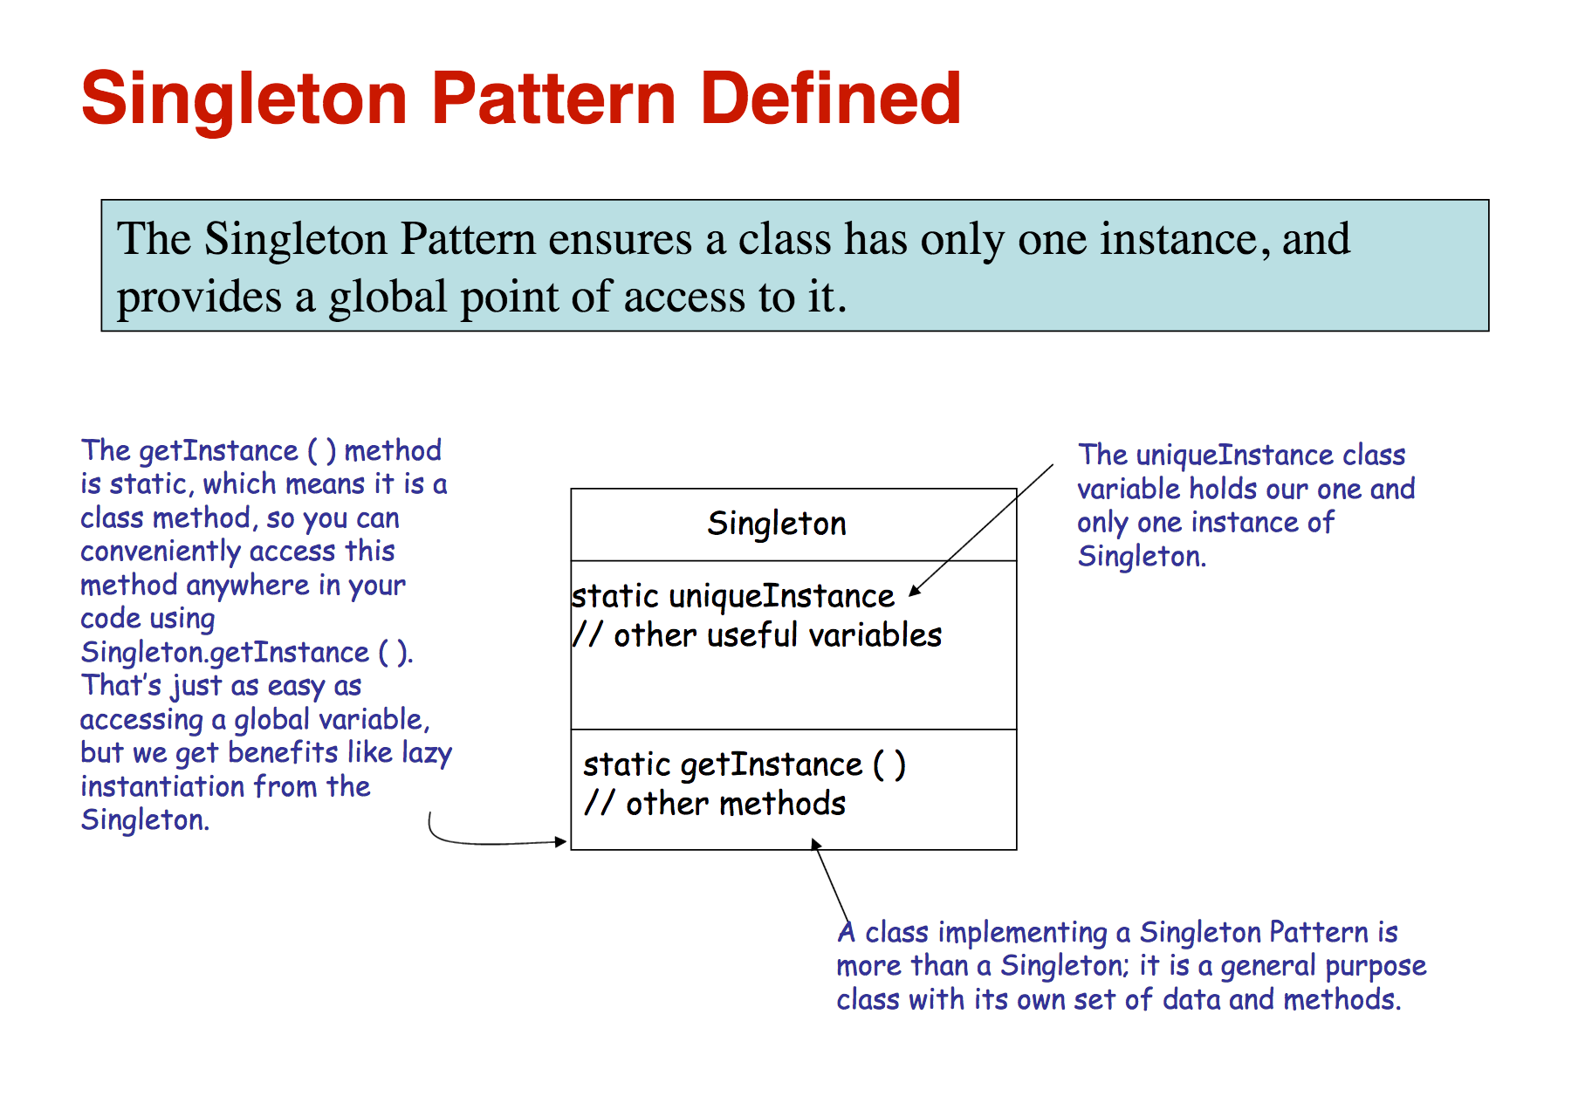

Slide 16
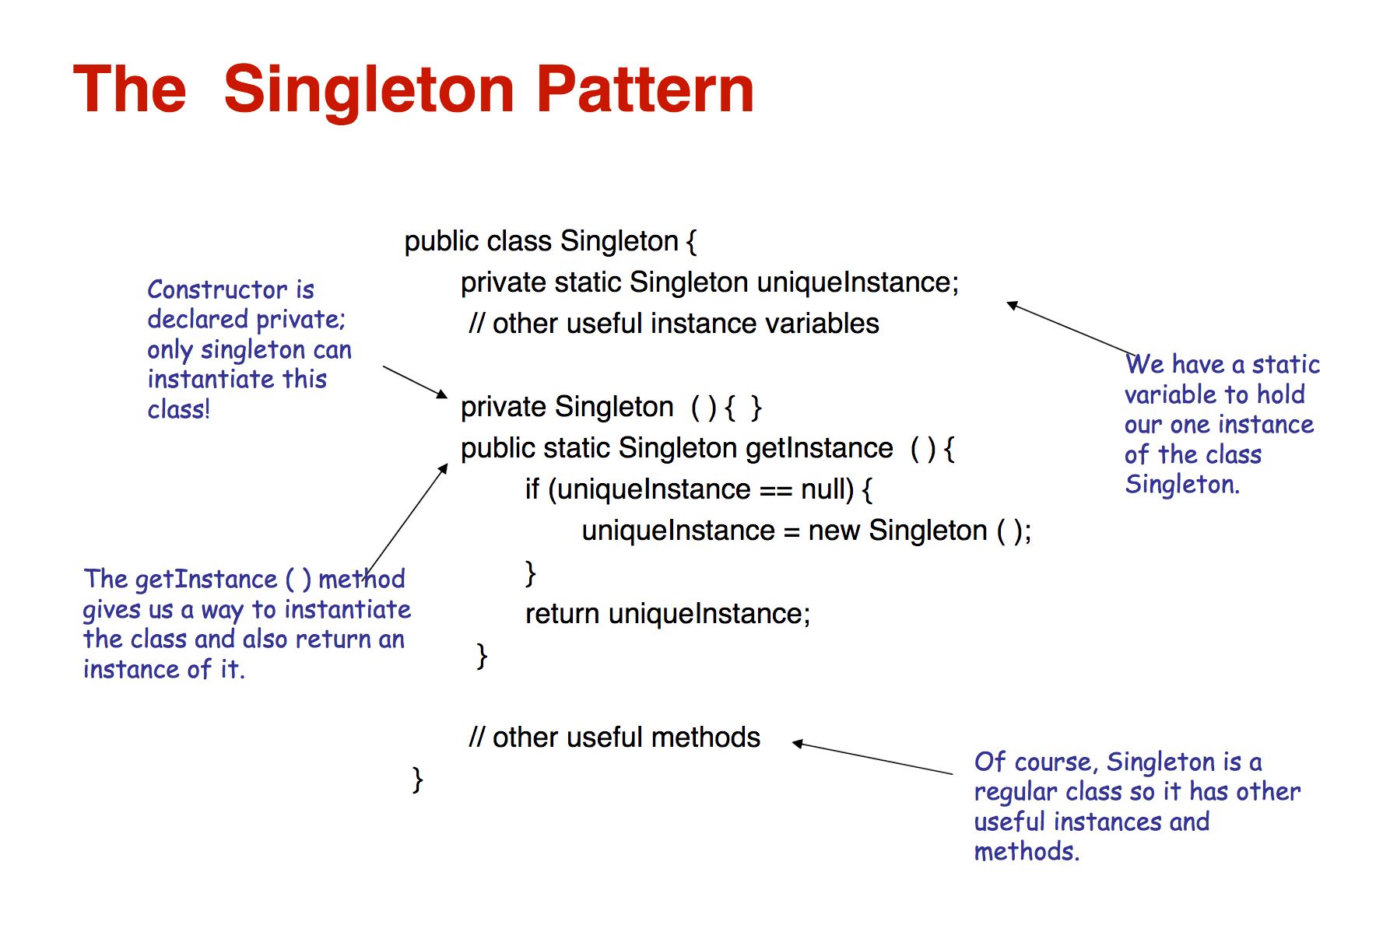

Slide 17
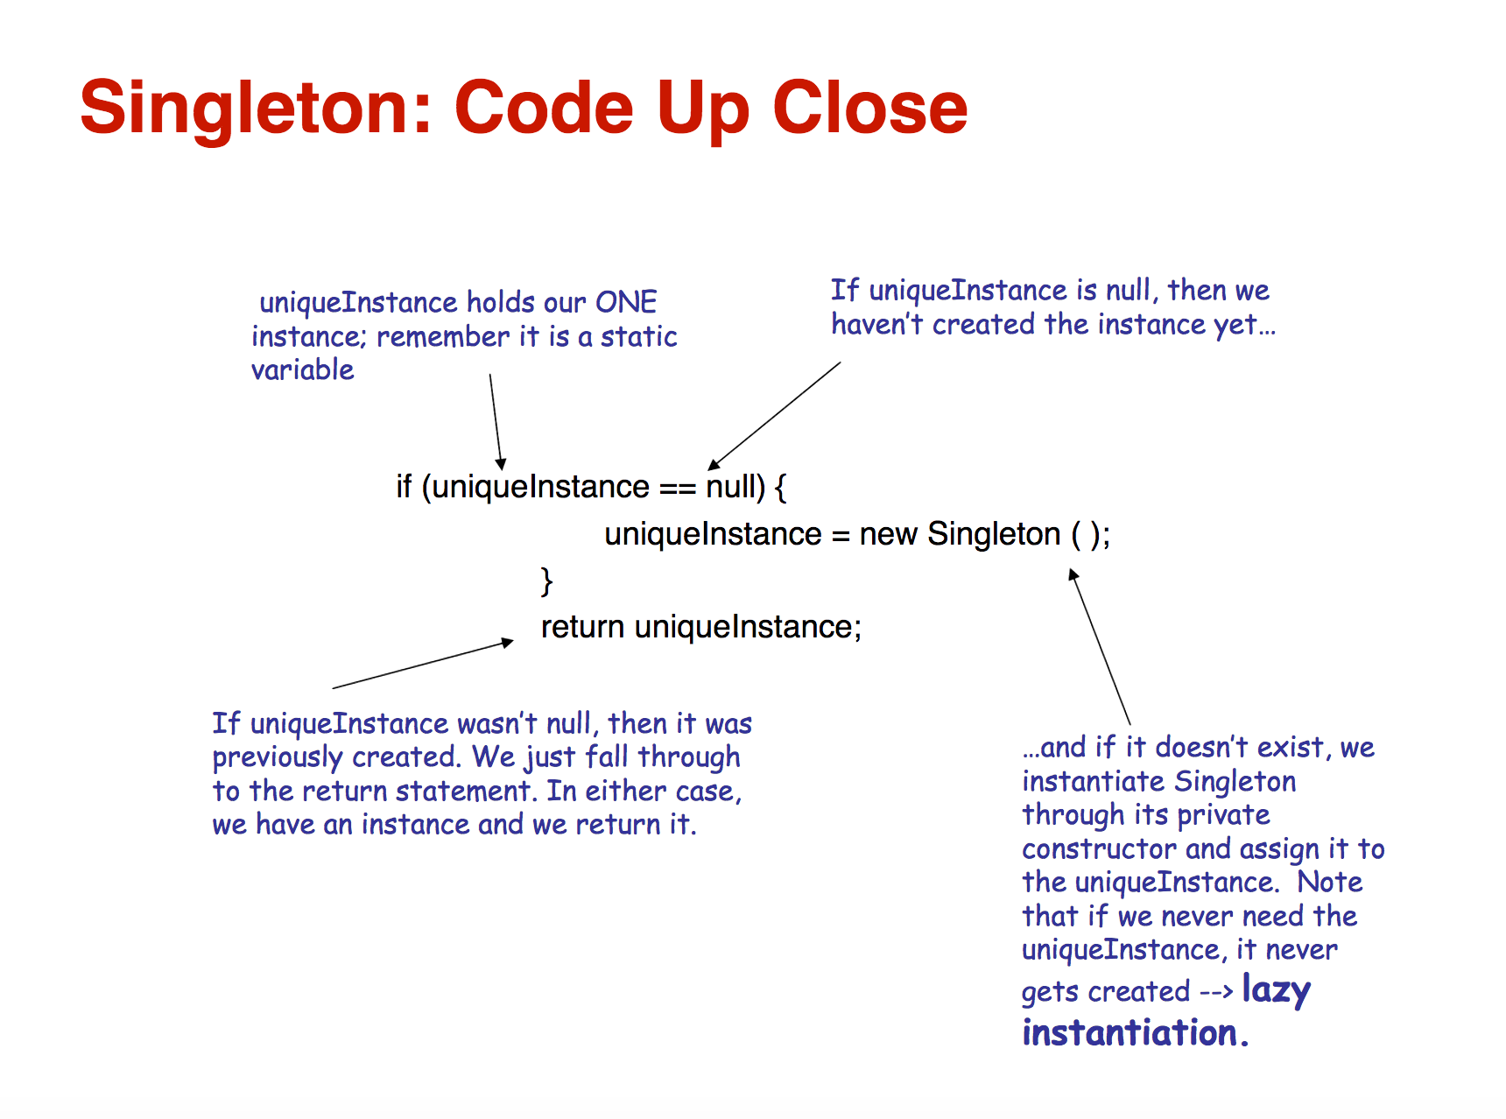

Slide 18
Inheritance Summary
The sub-class can share state with the base class. Now you have two objects that share state.
“Gang of Four” recommends usages of a registry of Singletons. The base class reads an environment variable to determine which Singleton to use.
Bottom Line: Singletons and Inheritance do not mix well.
18

Slide 19
Add Registry to Singleton
public class BaseSingleton
{
protected BaseSingleton() { }
private static HashMap map = new HashMap();
public static BaseSingleton getInstance(String classname)
{
//First, attempt to get Singleton from HashMap
BaseSingleton singleton = (BaseSingleton)map.get(classname);
if (singleton != null)
return singleton;
else
{
//Singleton not found
if (classname.Equals("SubClassSingleton"))
singleton = new SubClassSingleton();
else ......
//Add singleton to HashMap so we can get it again
map.put(classname, singleton);
return singleton;
}

Slide 20
SingletonRegistry Class
Source
  http://www.javaworld.com/javaworld/jw-04-2003/jw-0425-designpatterns.html?page=6
Describes a SingletonRegistry whose purpose is to store Singletons!
public static Singleton getInstance() { return (Singleton)SingletonRegistry.REGISTRY.getInstance(classname); }

Slide 21
Case Study: Dependencies
public class Searcher
{
//Singleton Setup code Here
public Collection FindCustomers(String criteria) {
String conStr = GetConnectionFromRegistry();
OracleConnection conn = new OracleConnection(conStr);
//Query database using criteria
return (Collection of customers);
}
}
21

Slide 22
Case Study: Dependencies
To search the database, the client code would need to do the following:
Searcher.getInstance().FindCustomers(“some criteria”)
What happens if we need to change the database to SQL Server? Or change how we get the connection string?

Slide 23
Case Study: Dependencies
The Singleton is tightly coupled to Oracle. If the database changed in the future, this object would need to be changed. It is also tightly coupled in how it retrieves the connection string.
The Singleton hides object dependencies (Oracle and registry). Anyone using the Singleton would need to inspect the internals to find out what is really going on.
Possibly memory leak since the Singleton may hold onto the resource for an infinite amount of time.
23

Slide 24
Unit Testing
There are many problems with unit testing a Singleton.
Problem: If you are running multiple unit tests that accesses the same Singleton, the Singleton will retain state between unit tests. This may lead to undesired results!
Solution : Use Reflection to get access to the private static instance variable. Then set it to null. This should be done at the end of each unit test.
private static Singleton uniqueInstance;
24

Slide 25
Unit Testing
Other problems
  You want to unit test a method of a Singleton, but the method refers to other external resources. It is hard to inject a mock in this case.
  You are unit testing a method that does a lot of business logic. One of the method calls is a Singleton that accesses an external resource. How can you replace the Singleton with a mock call?

Slide 26
Scott Densmore “Why Singletons are Evil”
“…the dependencies in your design are hidden inside the code, and not visible by examining the interfaces of your classes and methods. You have to inspect the code to understand exactly what other objects your class uses.
“Singletons allow you to limit creation of your objects... you are mixing two different responsibilities into the same class.”
“Singletons promote tight coupling between classes.”
“Singletons carry state with them that last as long as the program lasts…Persistent state is the enemy of unit testing.”
Source: http://blogs.msdn.com/scottdensmore/archive/2004/05/25/140827.aspx
26

Slide 27
Jeremy D. Miller “Chill out on the Singleton…”
“Using a stateful singleton opens yourself up to all kinds of threading issues. When you screw up threading safety you can create really wacky bugs that are devilishly hard to reproduce.
My best advice is to not use caching via static members until you absolutely have to for performance or resource limitation reasons.”
Source: http://codebetter.com/blogs/jeremy.miller/archive/2005/08/04/130302.aspx
27

Slide 28
“How to Decontaminate a Singleton”
“Define a Spring bean for each Singleton you use. For new DI-like implementations use the Spring bean as a wrapper that allows to access the functionality of the Singleton.”
http://blog.rainer.eschen.name/2006/12/15/how-to-decontaminate-a-singleton/
28

Slide 29
Comments from Others
“Sub-classing or creating mocks for Singletons is impossible (unless it implements an interface for its type)”
“It really should only be used in cases of classes for Constants for example.”
“Access to a singleton in an application must be serialized, which complicates multi-threading issues in applications hence introducing possible issues of thread locking.”

Slide 30
Comments from Others
“I had cases where I wanted to create a subclass, and the singleton kept referring to the superclass.”
“..writing a good unit test was impossible because the class invoked a singleton, and there was no way to inject a fake.”
“Unit testing a singleton is not so much a problem as unit testing the other classes that use a singleton. They are bound so tightly that there is often no way to inject a fake (or mock) version of the singleton class. In some cases you can live with that, but in other cases, such as when the singleton accesses an external resource like a database, it's intolerable for a unit test.”

Slide 31
Other Useful Articles
Singleton Explained
  http://c2.com/cgi/wiki?SingletonPattern
  http://www.oodesign.com/singleton-pattern.html
Unit Testing
  http://imistaken.blogspot.com/2009/11/unit-testing-singletons.html
  http://weblogs.asp.net/okloeten/archive/2004/08/19/217182.aspx

Slide 32
SUMMARY
Pattern Name – Singleton
Problem – Ensures one instance of an object and global access to it.
Solution
  Hide the constructor
  Use static method to return one instance of the object
Consequences
  Lazy Instantiation
  Threading
  Inheritance issues
  Hides dependencies
  Difficult unit testing
32

